Slide 1


Slide 2

Team Name: Hack Attackers
Team Leader Name: Joel Jacob John
Team Member Names: Joel Jacob John, Geethu T
Problem Statement Category: Foundational or Scalable Solution
Problem Statement: Catalogue Scoring
*You can make a copy of the slides. Do not change the template branding.

Slide 3
Architecture & Design for the innovative solution.
Modular architecture that provides flexible integration options.
Data Ingestion:
The process begins with the ingestion of product data from a data source such as a CSV file (in this case, "amazon_data_latest.csv").
Scoring Modules:
The core functionality of the system is divided into three scoring modules: compliance assessment, correctness assessment, and completeness assessment.
Each scoring module contains functions responsible for evaluating specific aspects of product quality based on predefined criteria.
Objective Score Computation:
The objective score computation component combines the individual scores obtained from the scoring modules to compute an overall objective score for each product.
It applies predefined weights to the individual scores based on the importance of each aspect of product quality, as specified in the scoring_parameters dictionary.
*You can make a copy of the slides. Do not change the template branding.

Slide 4
2. Tech evaluation would include the following
Reusability - of APIs, algorithms, data sets:
APIs for functions such as scoring compliance, correctness, and completeness can be reused across different projects or systems that require similar functionality for evaluating product catalogues.
Datasets containing product information, labels, and attributes can be reused for training and testing machine learning models, benchmarking performance, or conducting further analysis in retail-commerce.
Extensibility - to other use-cases:
Add New Scoring Criteria
Integrate Machine Learning Models
Support Multiple Data Sources
Integrate with External Systems like CRM,E-commerce platform..
Implement Feedback Mechanisms

Slide 5
Scalability - working at population scale with optimal capacity & minimal latency
By employing these scalability strategies, the catalogue scoring system can efficiently handle population-scale datasets with optimal capacity and minimal latency, ensuring responsiveness and reliability even under high loads and peak demand scenarios.
Security - ensuring transactional guarantees
Ensuring transactional guarantees and maintaining security in the catalogue scoring system involves implementing various measures to protect data integrity, confidentiality, and availability. Examples are Audit Logging, Data Masking and Anonymization...

Slide 6
Define customization & deployment options of your proposed solution.
Customization Options:
Scoring Parameters: Customize the weights assigned to different scoring parameters (e.g., compliance, correctness, completeness) based on domain knowledge or specific business requirements.
Additional Criteria: Extend the scoring system to include additional criteria such as product reviews, ratings, or sales performance, if relevant to your application.
Deployment Options:
Developed a Webapp which is hosted in Streamlit.
*You can make a copy of the slides. Do not change the template branding.

Slide 7
Test cases & data (as applicable) against which the eval criteria can be assessed
Test Case 1: Compliance Assessment
Evaluate the compliance scoring function to ensure it correctly assesses whether product labels and displays comply with applicable laws.
Test Case 2: Correctness Assessment
Evaluate the correctness scoring function to ensure it accurately determines product authenticity and appropriate branding.
Test Case 3: Completeness Assessment
Evaluate the completeness scoring function to ensure it properly assesses whether the catalogue provides the minimum attributes required for buyers to understand product features.
Test Case 4: Objective Score Calculation
Evaluate the computation of the objective store for a merchant catalog to ensure it correctly combines compliance, correctness, and completeness scores.
*You can make a copy of the slides. Do not change the template branding.

Slide 8
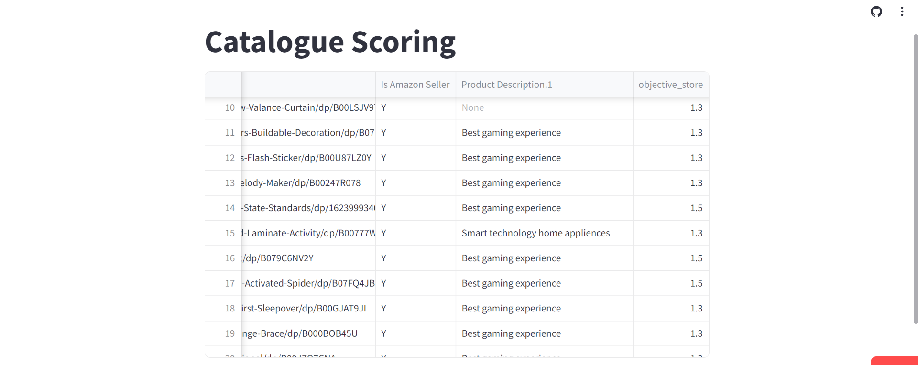
Demonstrate working of the solution to the evaluation team
*You can make a copy of the slides. Do not change the template branding.

Slide 9
Important Links:-
GitHub Public Repository Link (GitHub)
Working Website ( Website )
*You can make a copy of the slides. Do not change the template branding.

Slide 10


